Slide 1

Unblurring from nothing: How do diffusion models work?
Edmund Dable-Heath

Slide 2
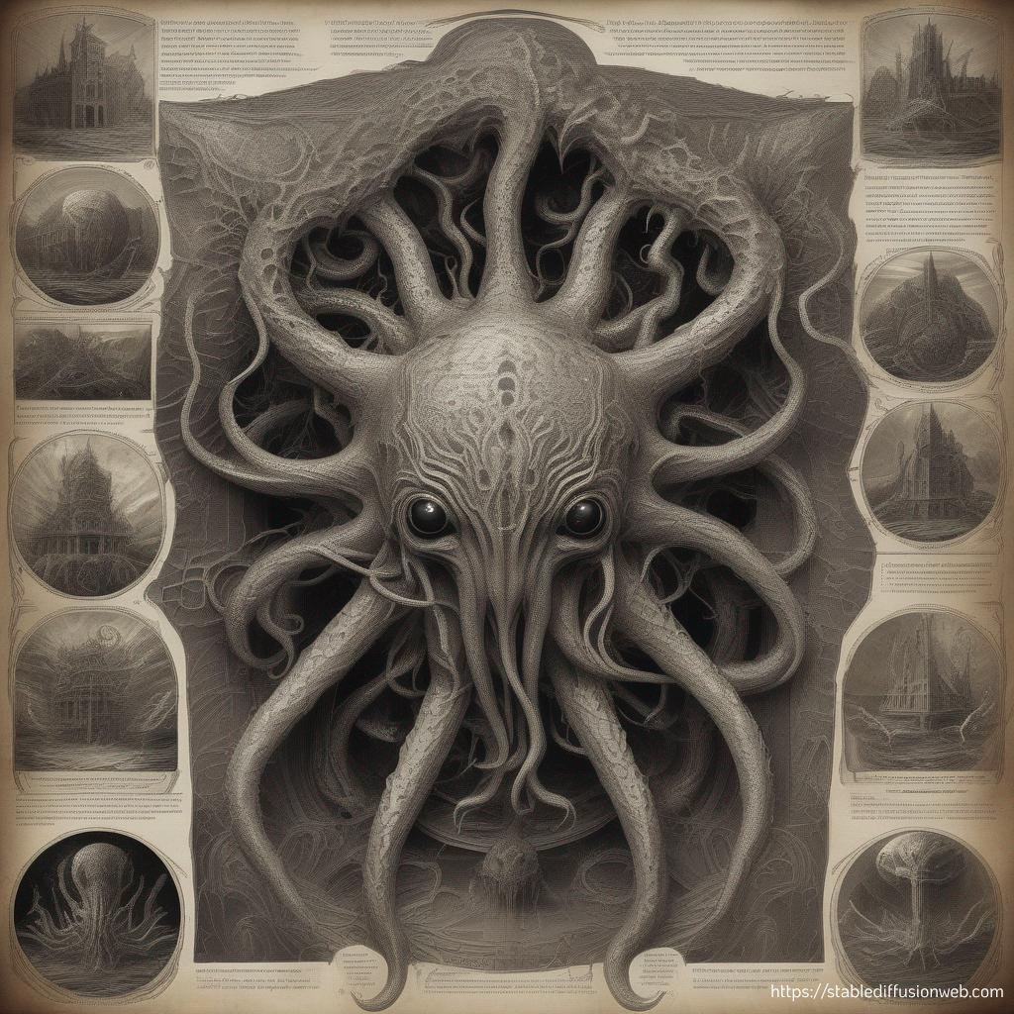
Outline
What is diffusion? Some intuition about what we’re trying to do.
Sampling methods
- U-Nets
How do we train these models?
And what if we want to ask it for a particular pretty picture?
Limitations and ethical quandaries.

Slide 3
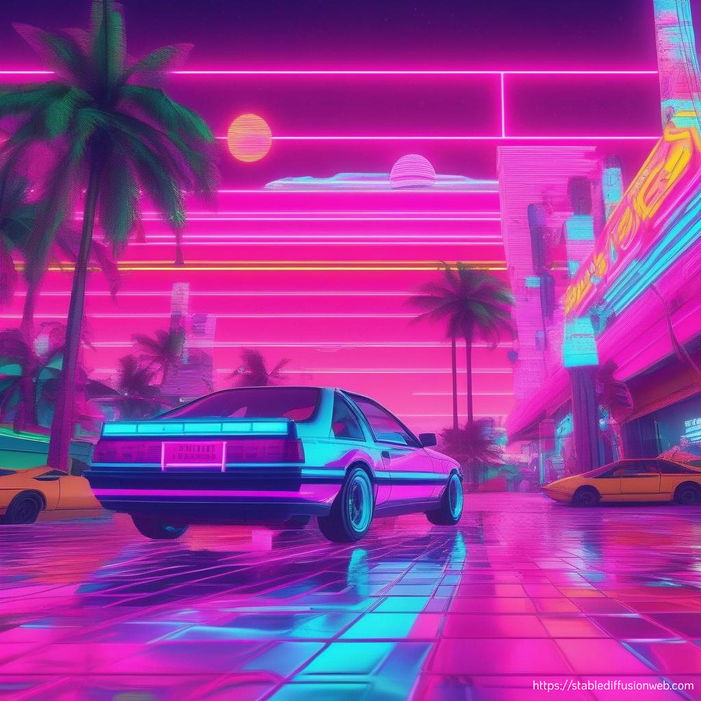
What is diffusion anyway?

Slide 4
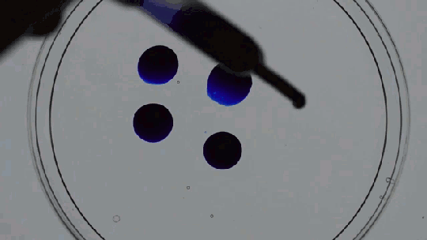
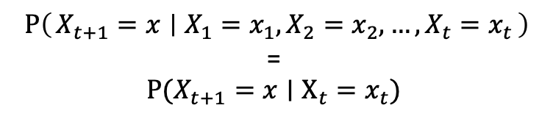
Diffusion in the physical world
Time-dependent random process of something moving from an area of high concentration to low concentration.
How do we model this?
If we know exactly how we got to a diffuse state, can we get back to a concentrated one?
$$P\left(X_{t+1}=x ∣ X_{1}=x_{1},X_{2}=x_{2},…,X_{t}=x_{t}\right)$$
=
$$P(X_{t+1}=x∣X_{t}=x_{t})$$
Notes:
If you've seen Oppenheimer, he's the one playing Bongos.

Slide 5
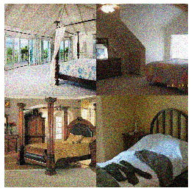
Diffusing Images
Consider an image as a concentrated collection of coherent information within pixel space.
Then we can think of adding noise – or blurring the image – as diffusion.
Taking a trip through the image library of babel.
Notes:
Explain dirac notation!

Slide 6
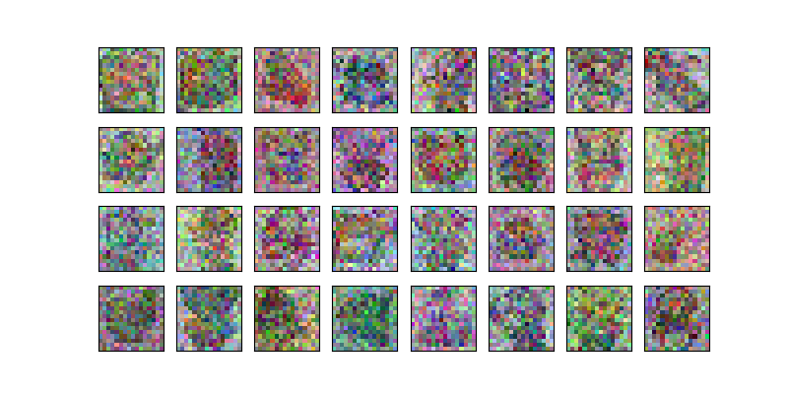
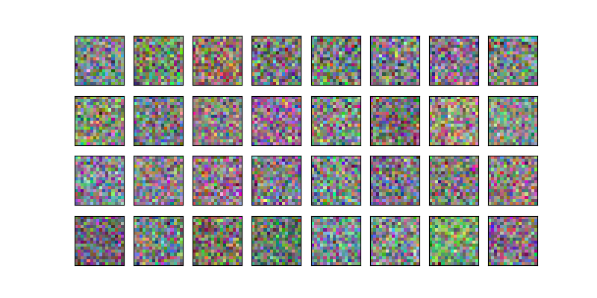
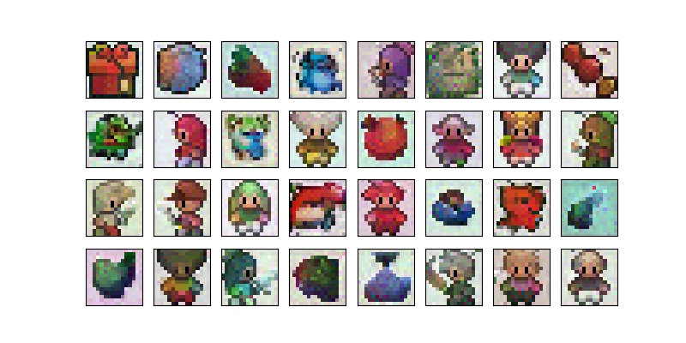
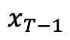
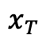
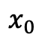
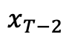
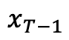
So what do these models look like?
Neural
Net
Remove
Noise
$$x_{T}$$
$$x_{T−1}$$
Neural
Net
Remove
Noise
$$x_{T−1}$$
$$x_{T−2}$$
Repeat
$$x_{0}$$

Slide 7
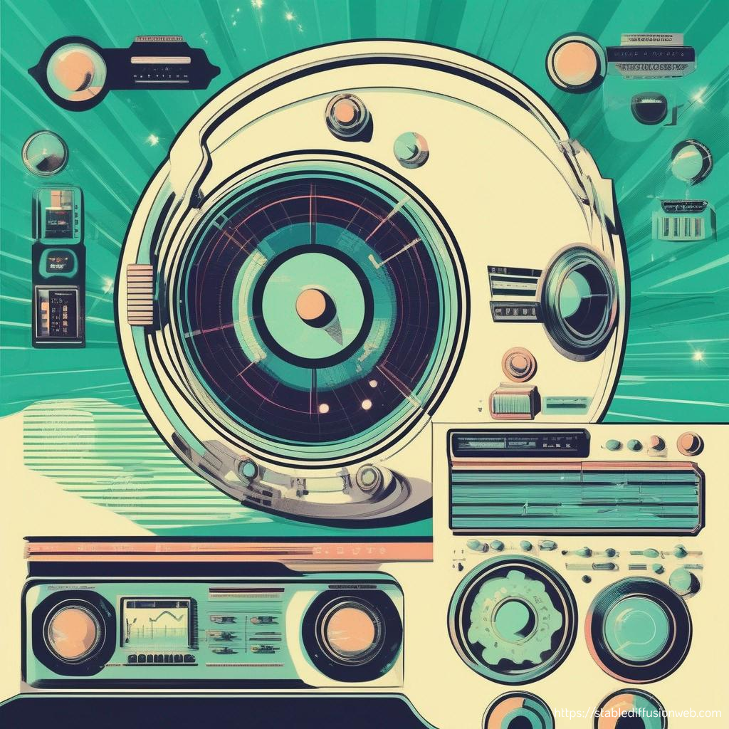
Noise-cancelling sampling

Slide 8
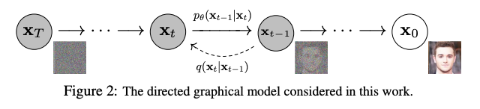
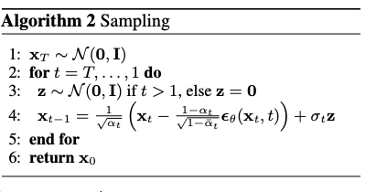
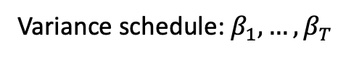
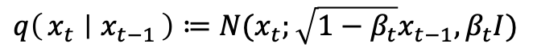
Denoising Diffusion Probabilistic Models
General idea: learn the information about the scheduling of the variance of the distributions adding noise throughout the process.
Use this information to run the process backwards from a random sample.
Variance schedule: $β_{1},…,β_{T}$
$$q\left(x_{t} ∣ x_{t−1}\right)≔N(x_{t};\sqrt{1−β_{t}}x_{t−1}, β_{t}I)$$

Slide 9
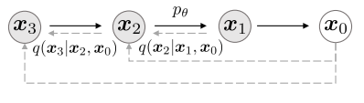
Denoising Diffusion Implicit Models
Instead of learning a random process, this generalizes to non-Markovian processes from which you sample an entire process.
This allows you to be much faster as it ends up being deterministic.

Slide 10
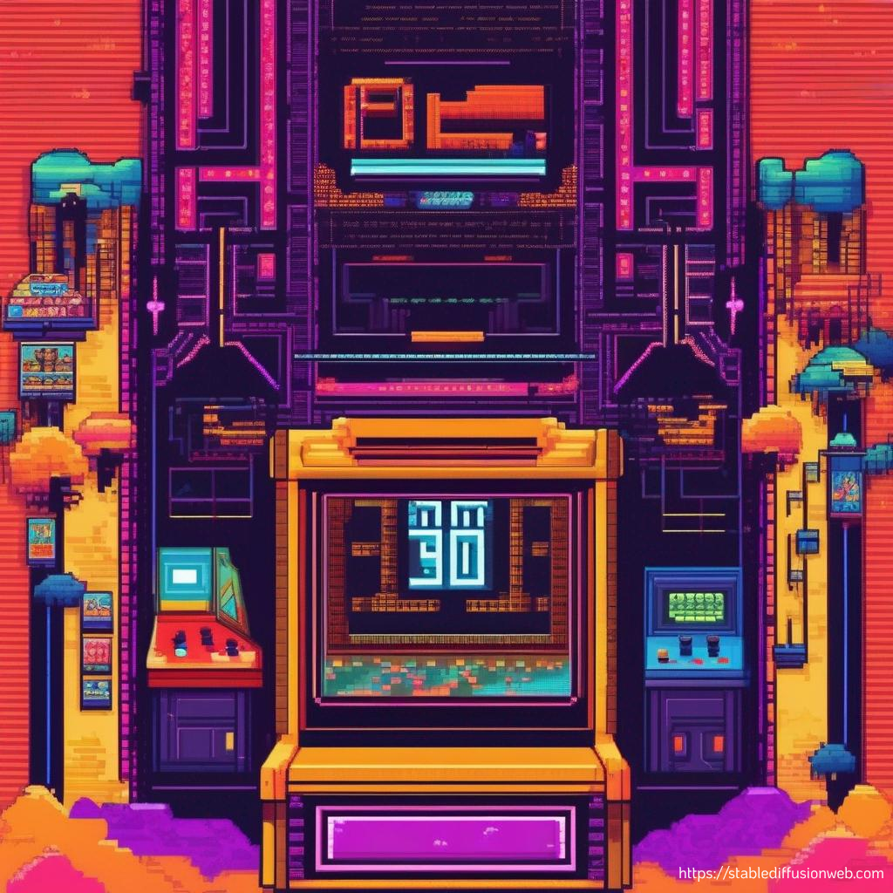
U-Nets all the way down (and then back up again)

Slide 11
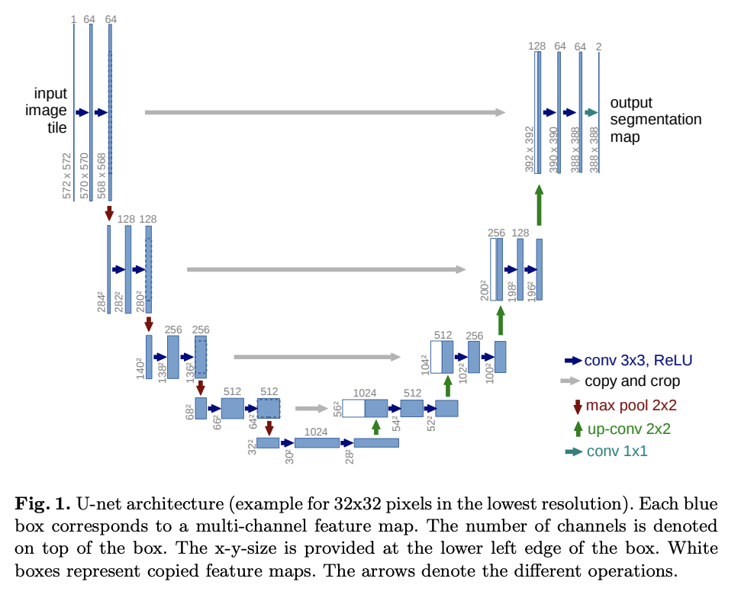
What are U-Nets?
A U-shaped convolutional neural network.
Initially created for image segmentation.
Down-samples images to distill information, before up sampling (with skip connections) to return to original resolution.
For diffusion models this learns the noise distribution on an image – i.e. ‘segmenting’ the noise from the image.

Slide 12
Including Additional Information
Up 2
Up 1
In addition to simply learning the noise we want to know the noise in context.
Noise from which time step?
Context from user?
Up 0
Hidden
Embeddings
Time
Context

Slide 13
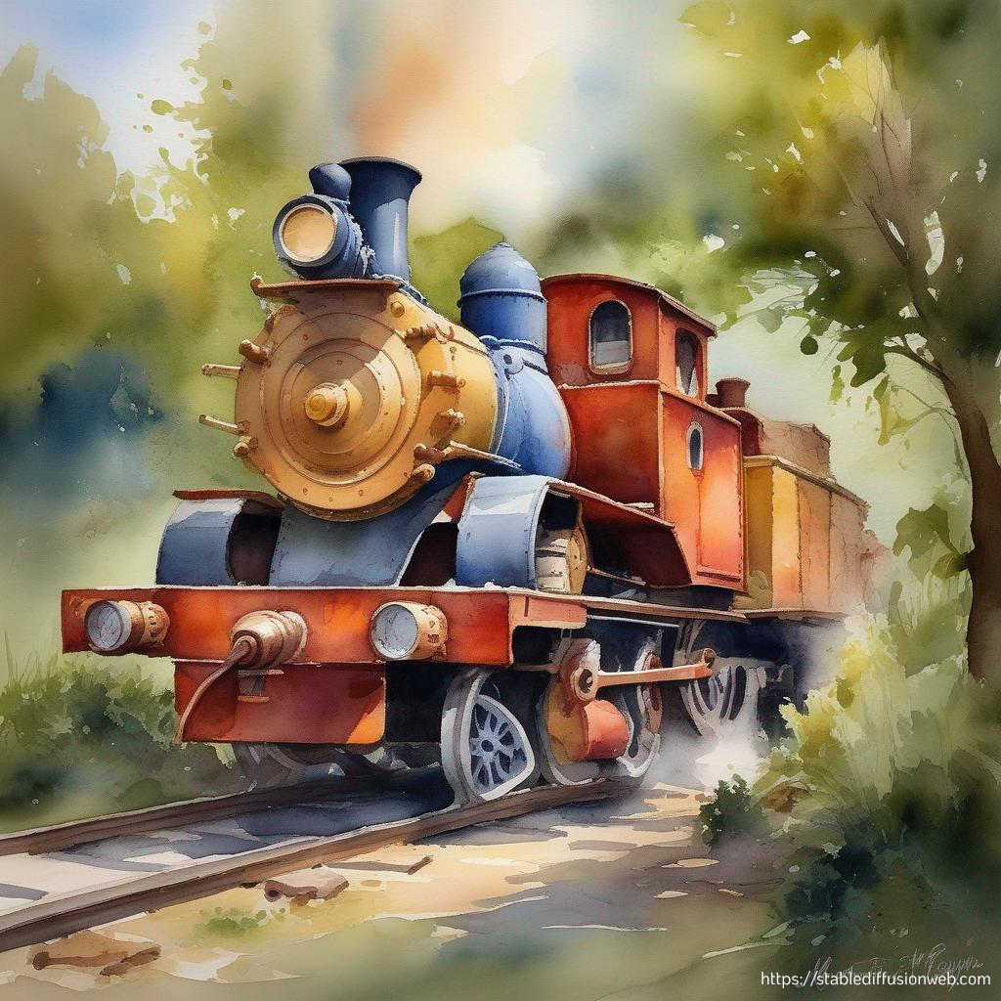
Art lessons for machines: how do we train these models?

Slide 14
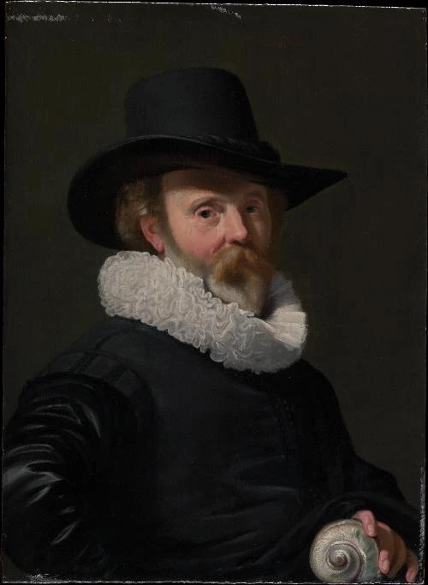

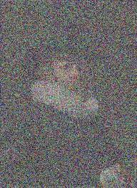
What is it actually trying to learn?
Learns the noise at each time step so it can run the process backwards to a noiseless-image.
Synthesise data by adding noise different amounts of noise to training images to simulate different time steps.
Neural
Net
Loss

Slide 15
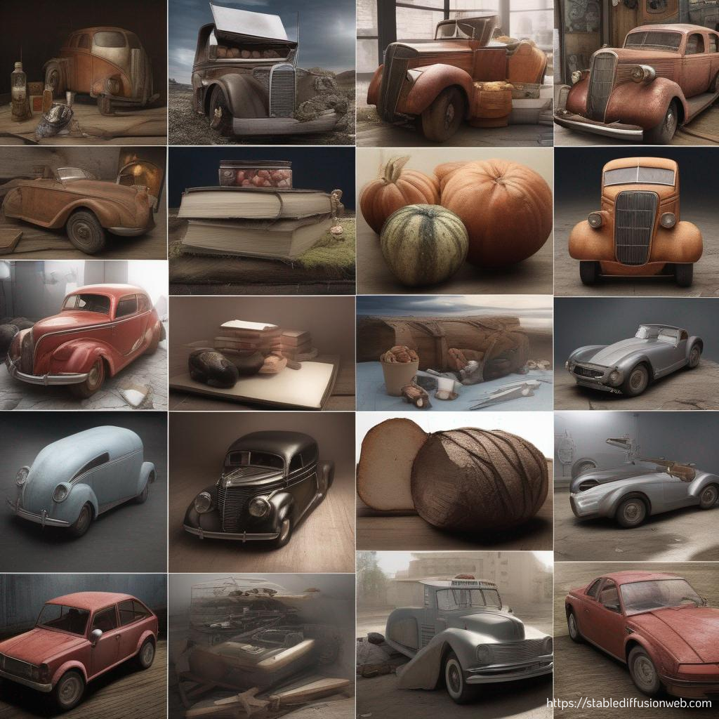
How to ask for pretty pictures: What do you want them to create for you?

Slide 16
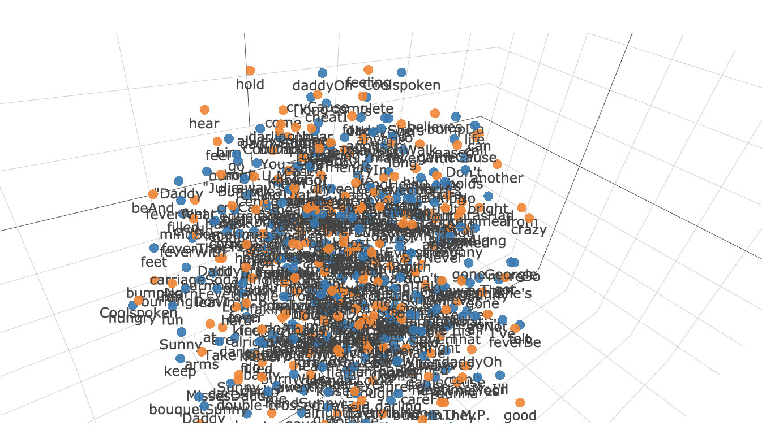
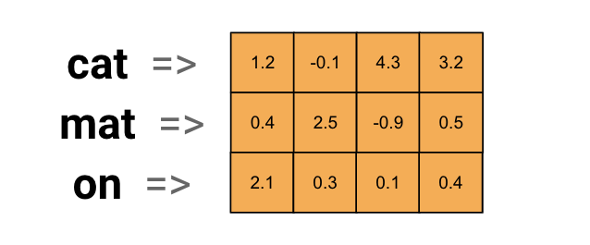
Our old friend: Word Embeddings
Given a reference dictionary and a learnt process we turn words (sentences, tokens, etc.) into vectors.
These vectors need to be of a matching dimension to the images to be incorporated into the model.

Slide 17
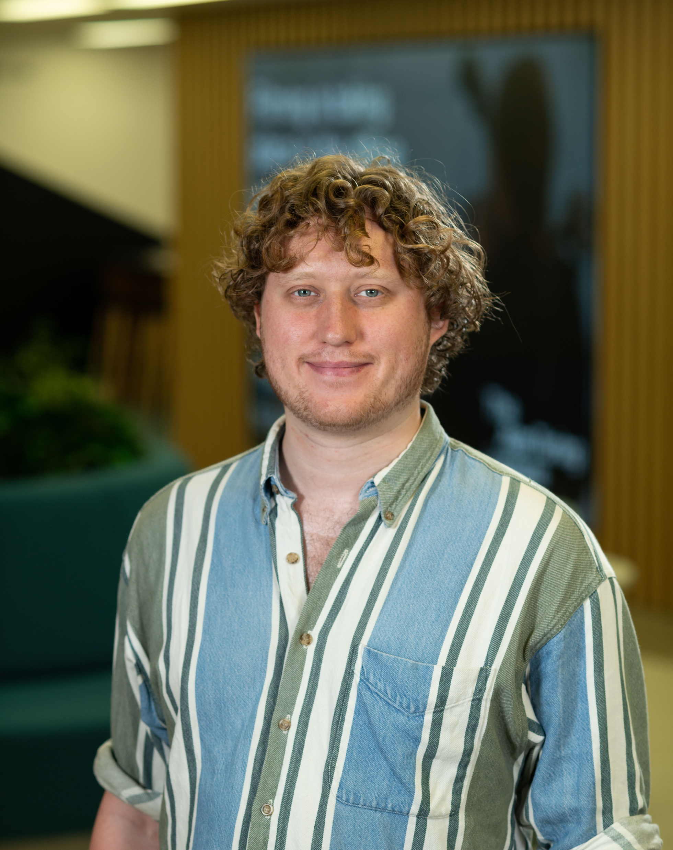
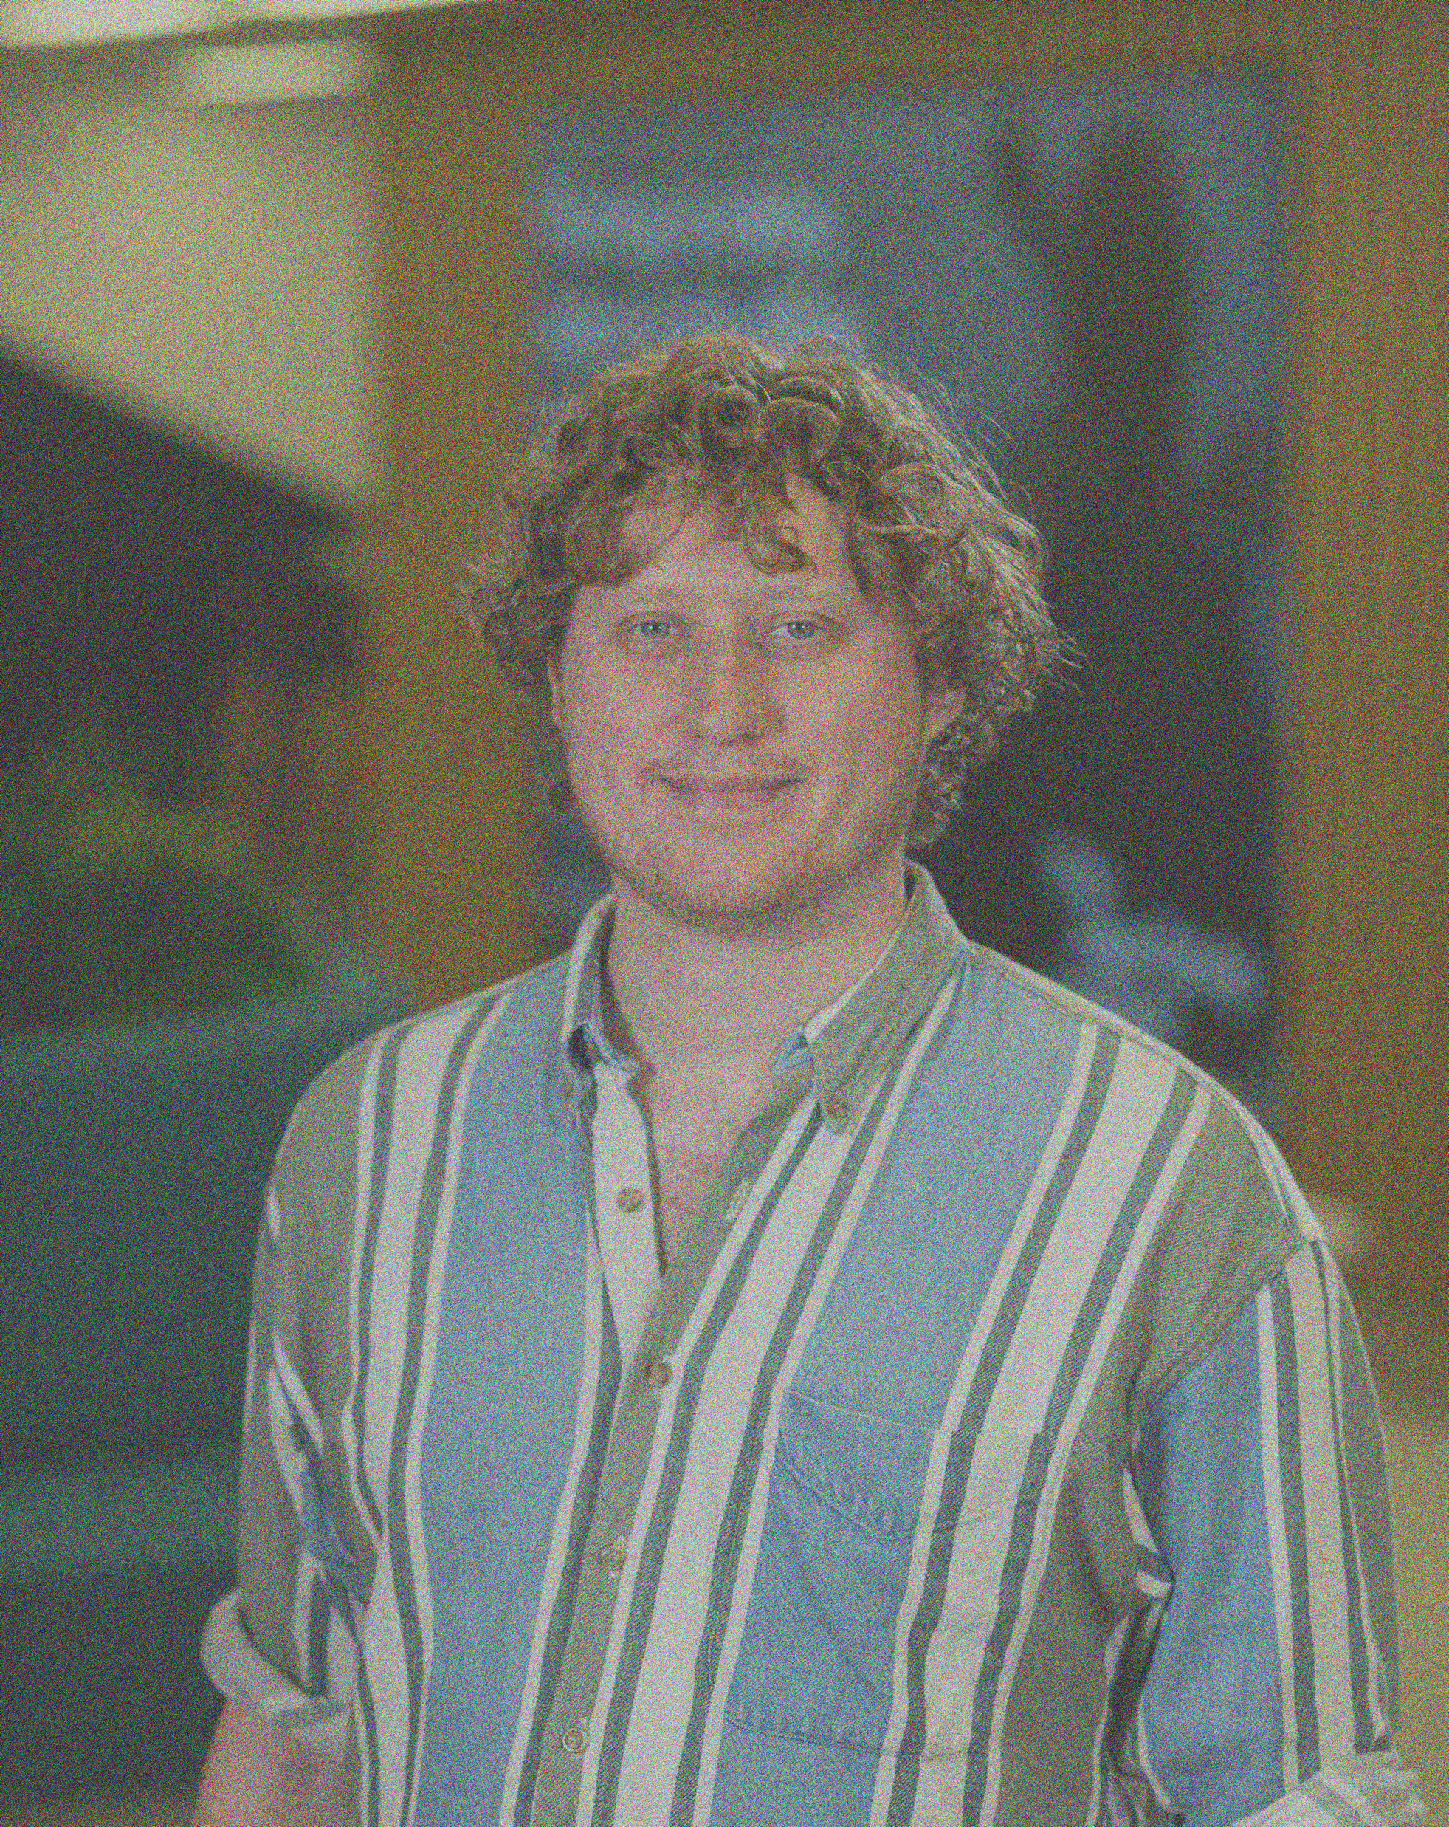
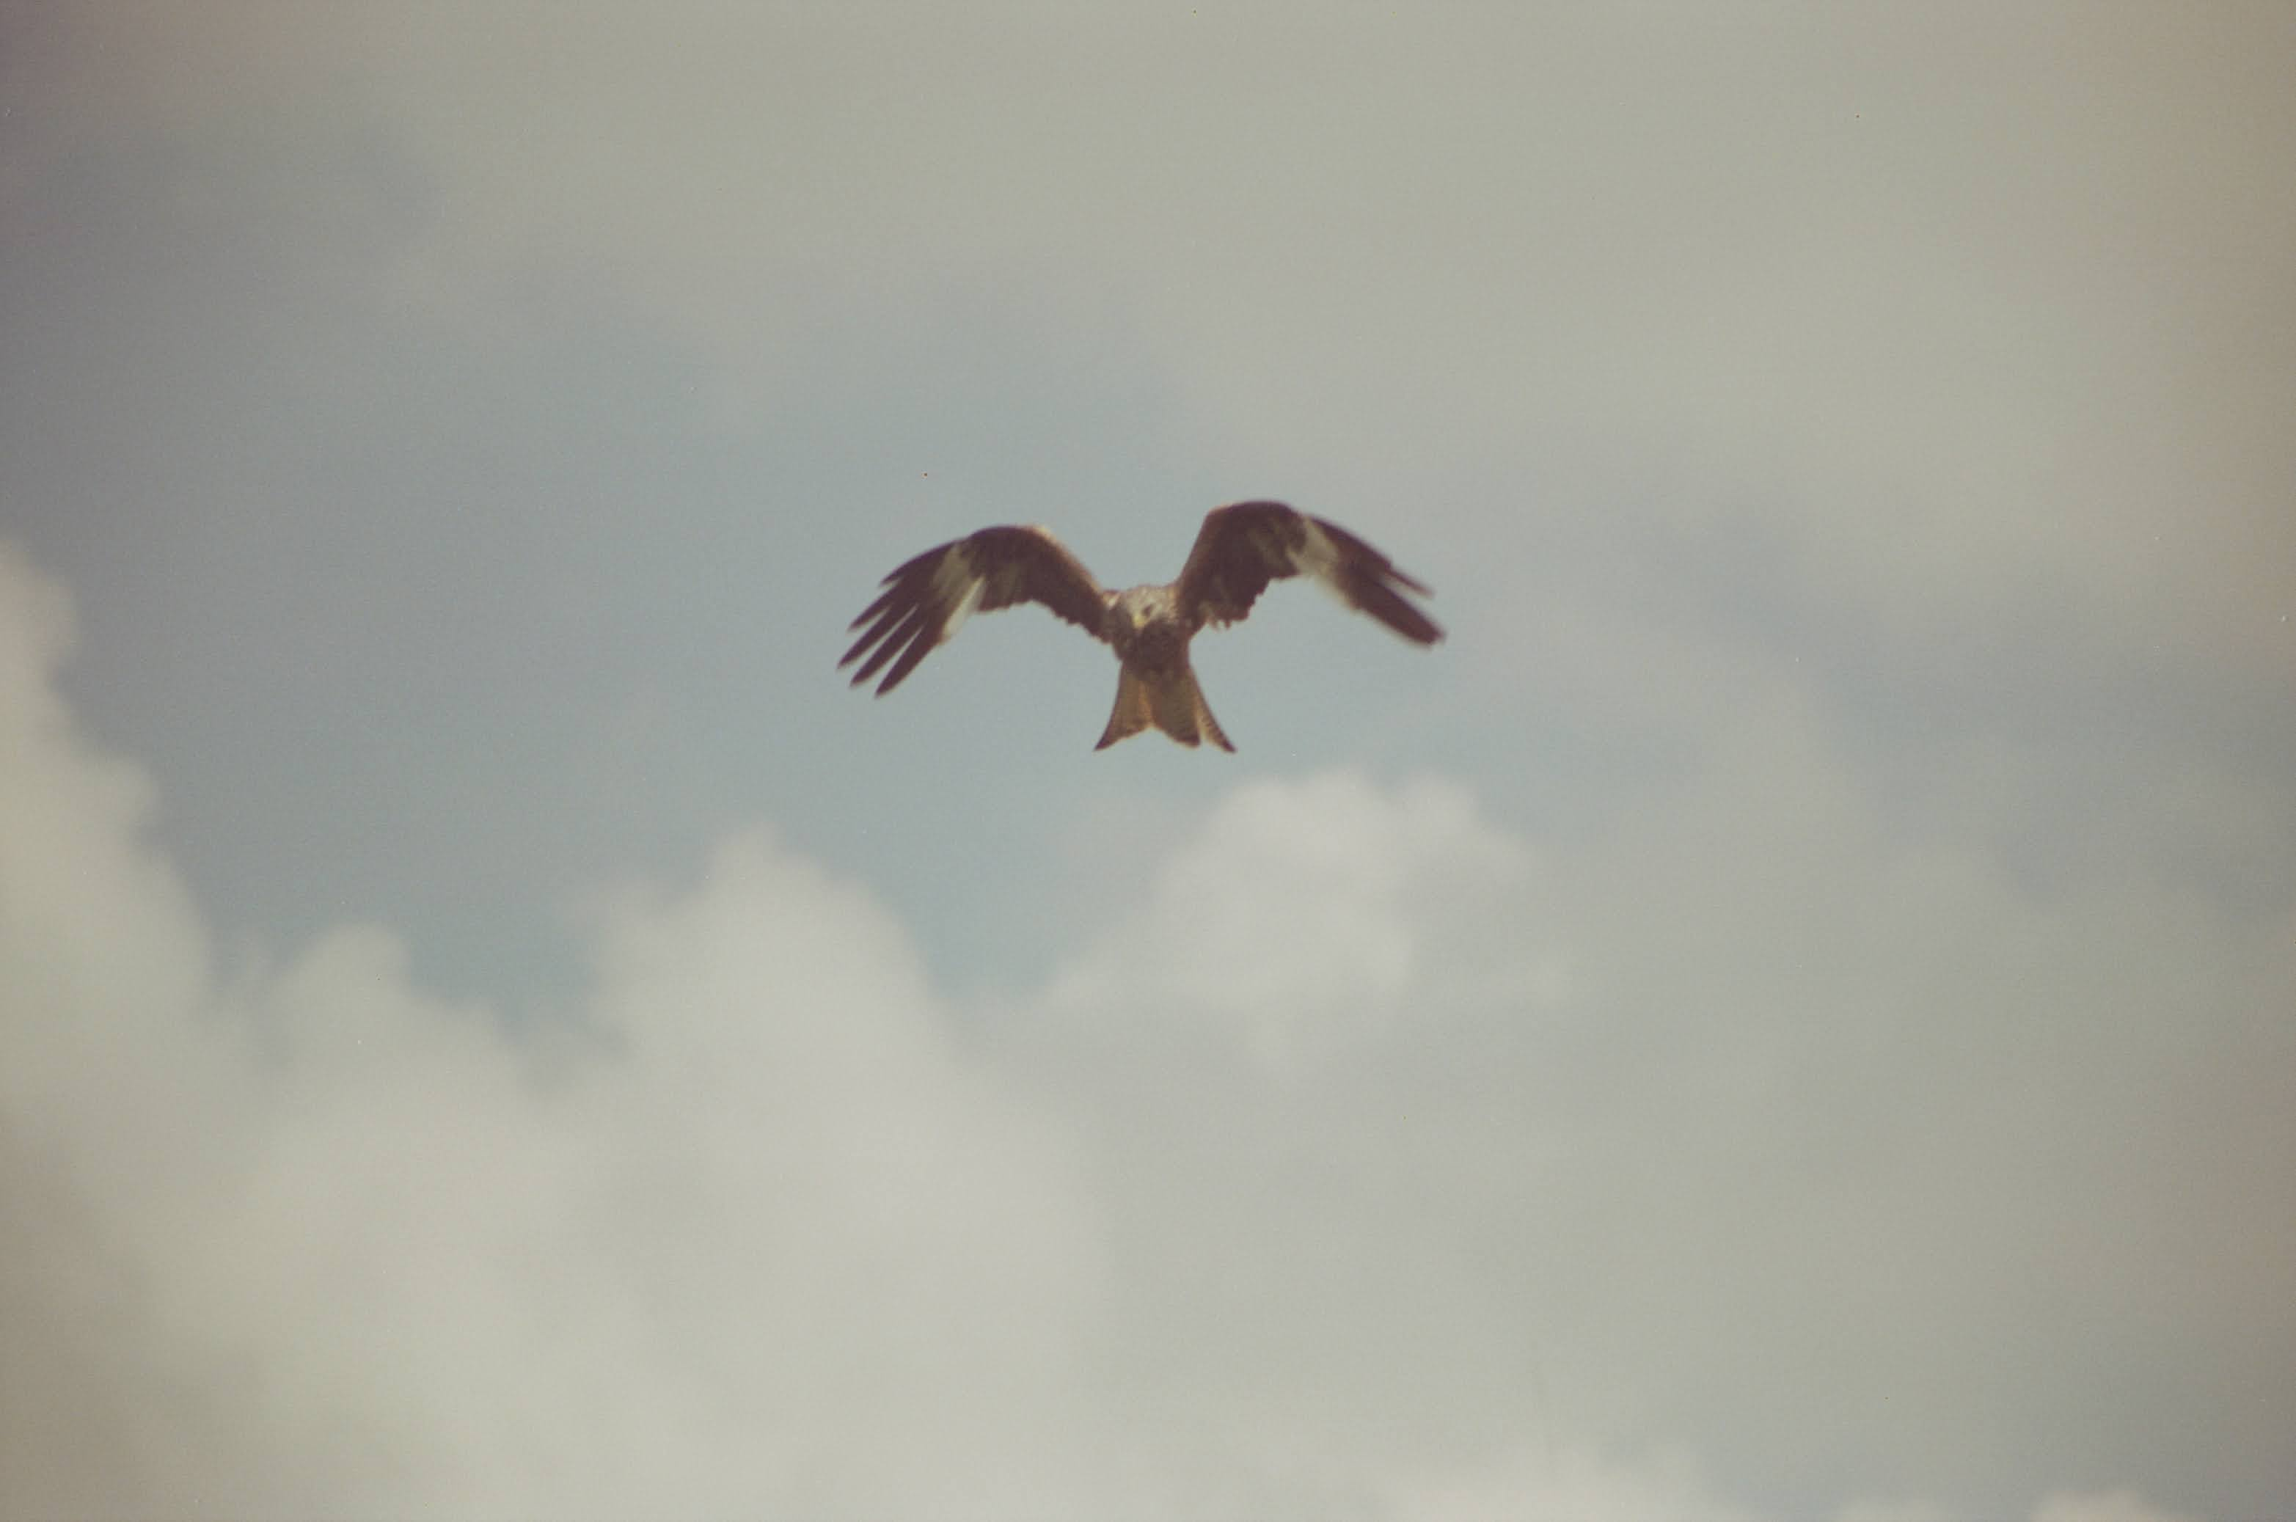
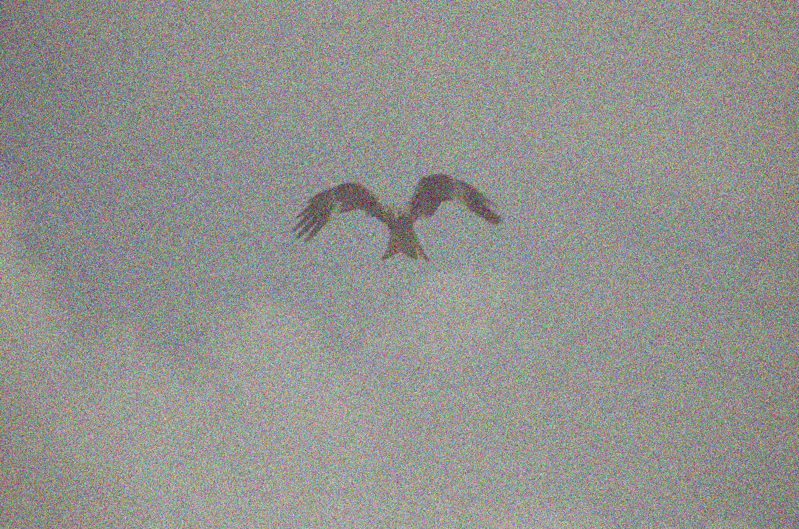
Adding Context at Training Time
‘A picture of me’
Neural
Net
Loss
‘A flying bird’

Slide 18
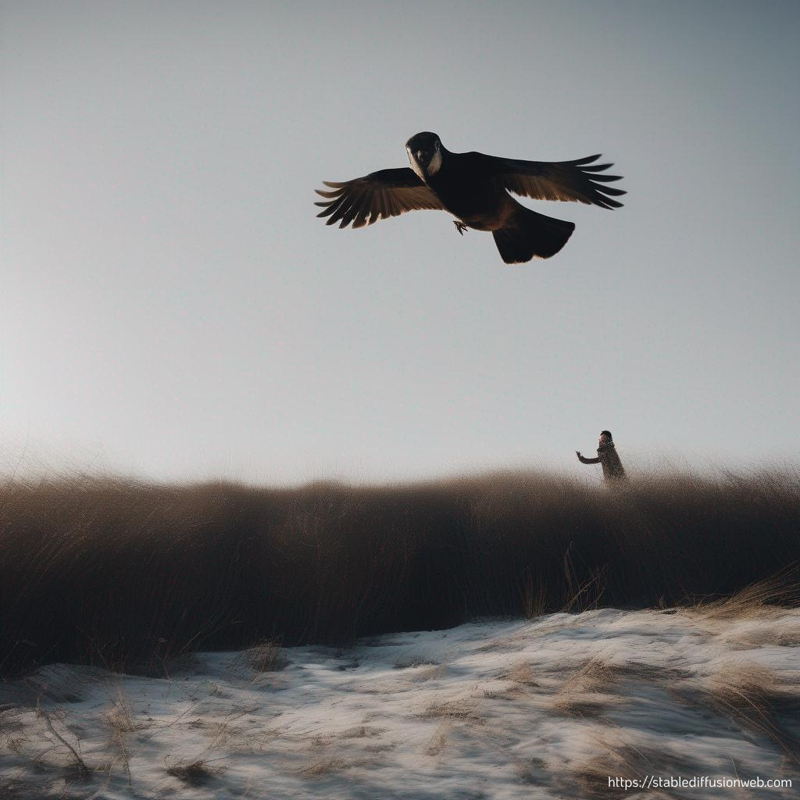
Giving Context at Sample Time
‘A picture of me flying like a bird’
Trained
Neural
Net

Slide 19
Alternative context to embeddings
Context just needs to be a vector to give to the model.
The source of the context could be text, categorical, other images etc.
Giving the model context it has never seen before will still create something new.

Slide 20
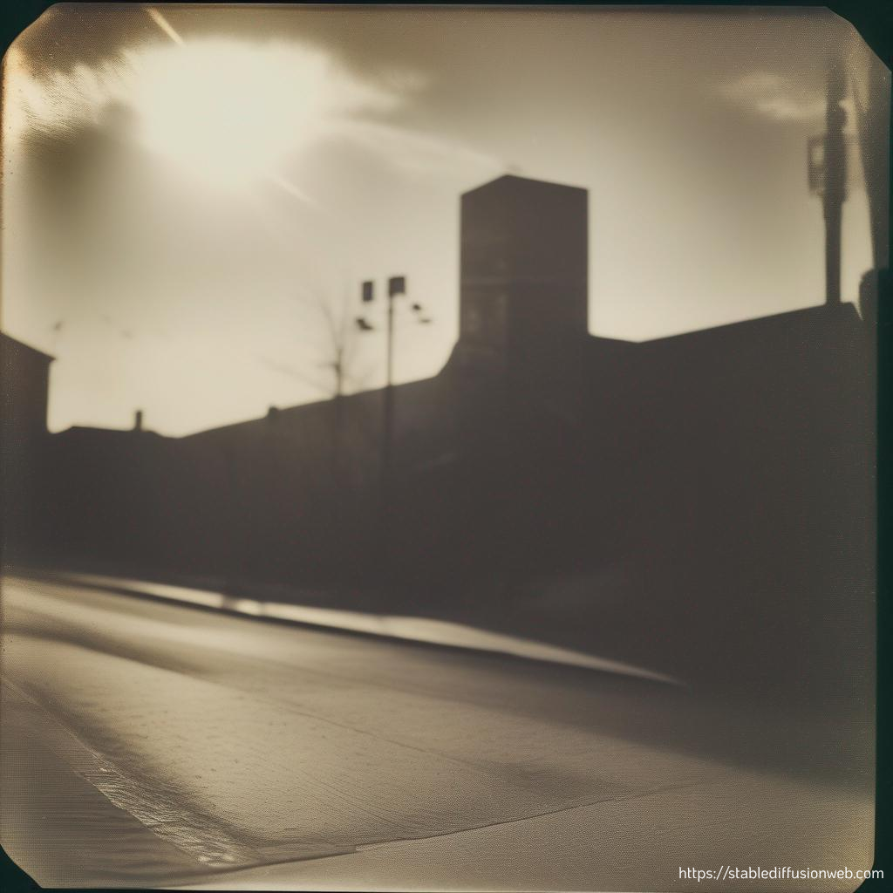
Limitations and ethical quandaries

Slide 21

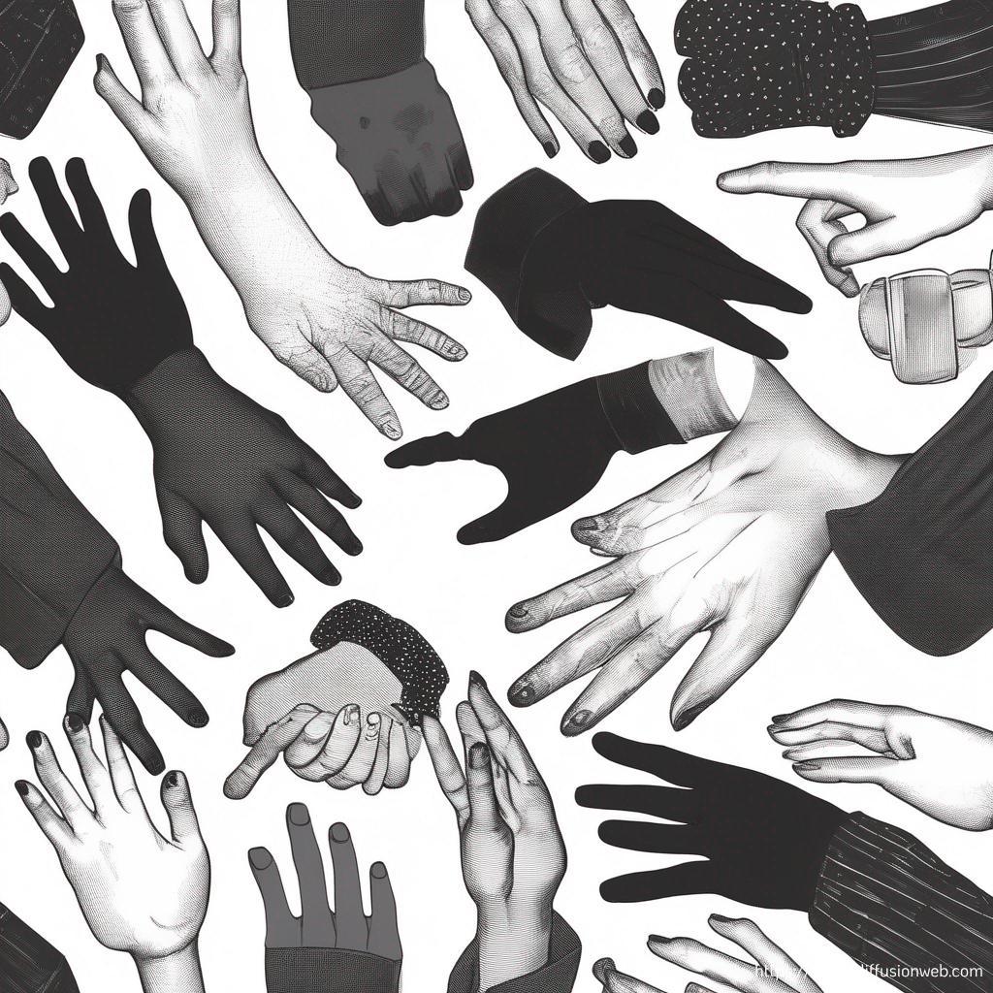
Limiting Factors
Can’t create new art styles. (Can it be creative?)
Fairly bad a writing.
Bad at hands???

Slide 22
Ethical Quandaries (deserves it’s own talk)
Stealing artists work for training data.
Biases in the dataset.
Generating images of others without consent.
Misinformation/misrepresentation.
Faking artwork???

Slide 23
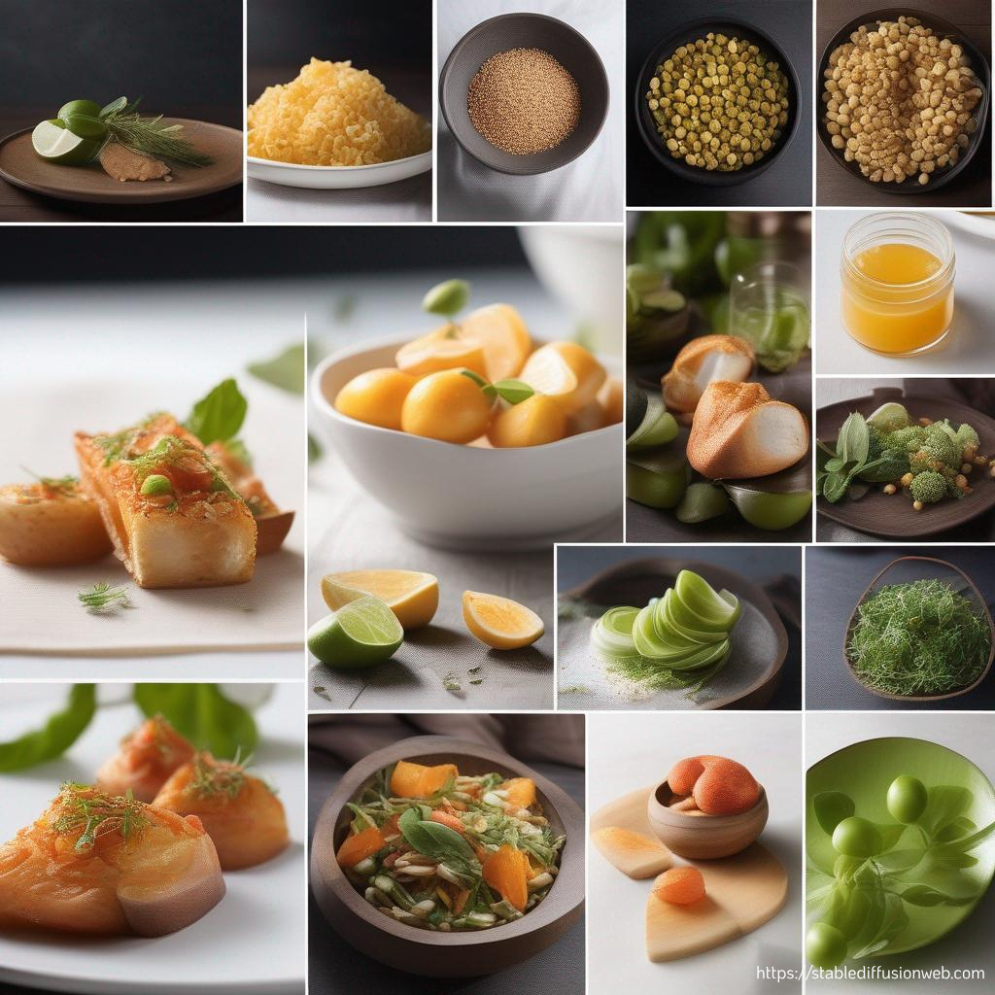
A sneak peak at stable diffusion

Slide 24
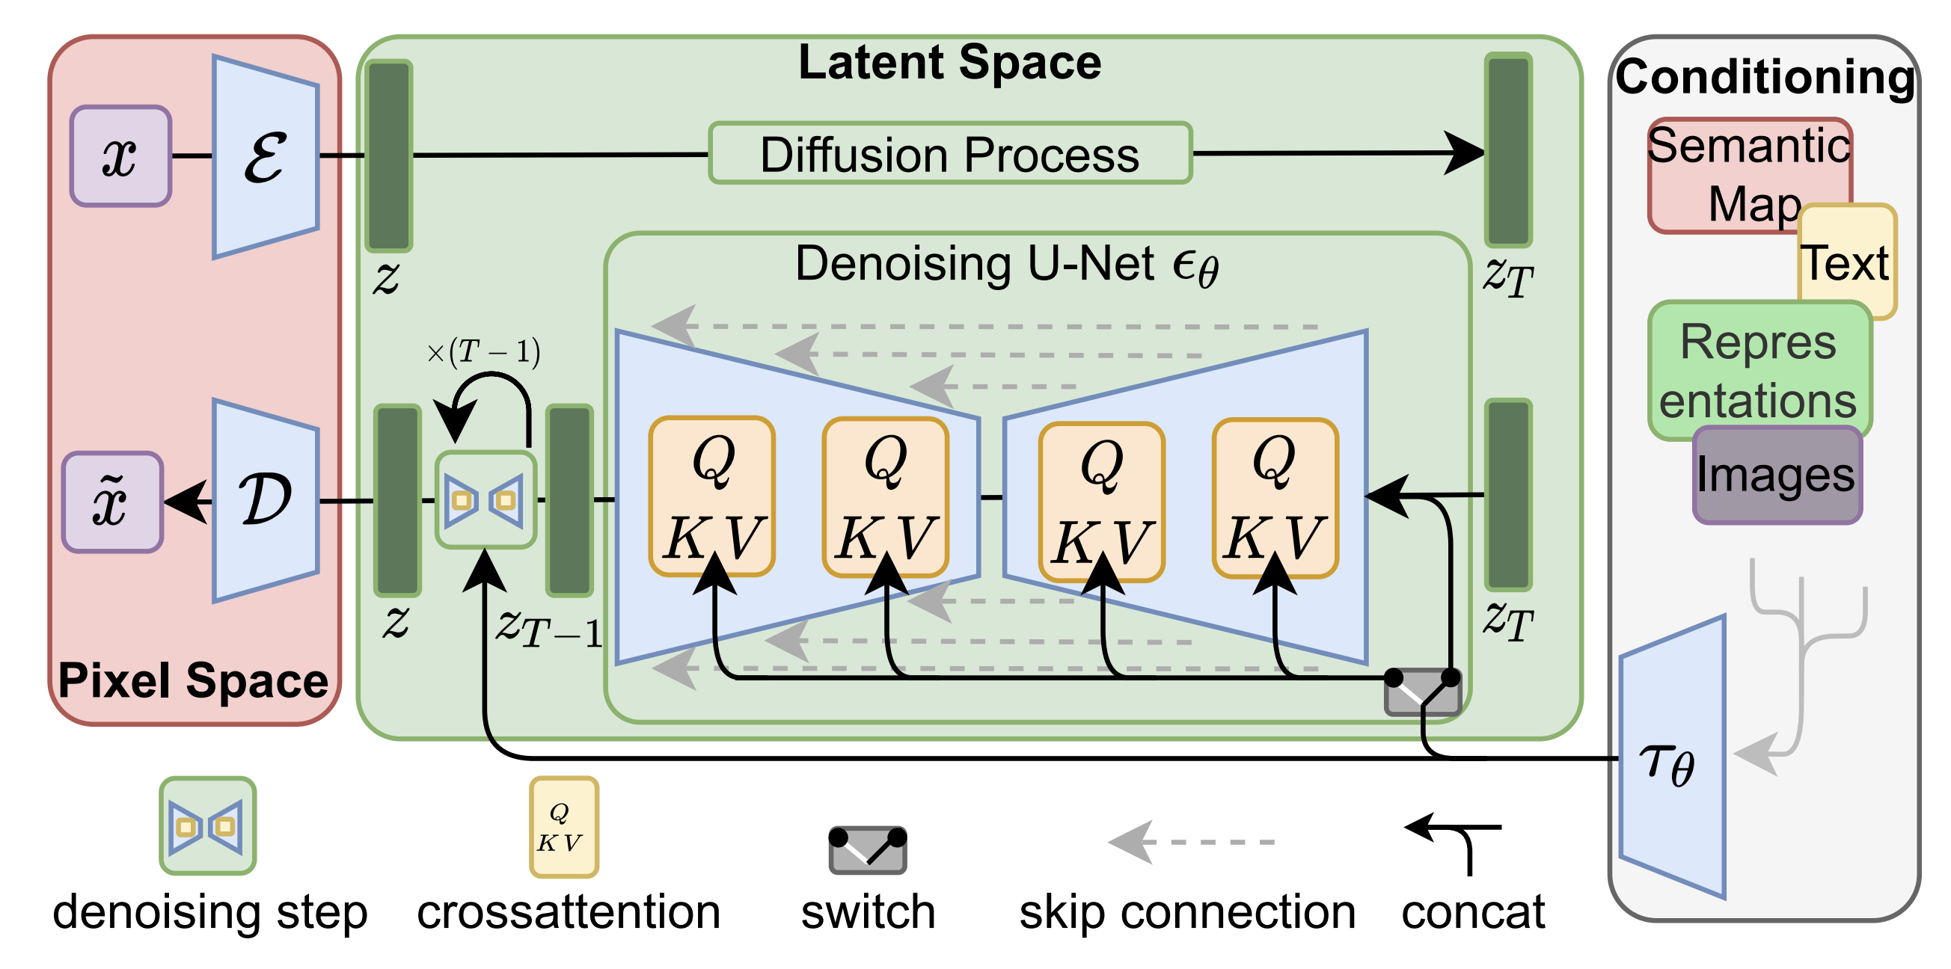

Slide 25

Thanks for Listening!

